Slide 1
The Agentic Framework for Operations
That Can't Fail.
Build, deploy, and govern autonomous enterprise agents on a unified execution runtime
The new business operation system (BOS)
Unified Agentic AI
Composable Modules
Low-Code Orchestration
Real-Team Data Fabric
Autonomous Workflows

Slide 2











Company Profile
CORE SERVICES
Consulting & Strategy
We offer complete turnkey solutions & services partner for digital transformation, specializing in consulting, IoT, network engineering, staff augmentation, and deployment services.
Enterprise & tech business consulting from global experts
IoT & M2M Solutions
Innovative, data-conscious & futuristic connected technologies
Networks & Engineering
Planning, operations, customer care & competitive benchmarking
HQ in New York
Staff Augmentation
Largest independent resource database via SWI Recruit
Est. 2004
20+
30+
Deployment Services
Founded
Years Exp.
Major Clients
Equipment installation, testing & commissioning
GLOBAL PRESENCE
100% Quality Assurance
USA
UAE
UK
Canada
KSA
Panama
swius.com | AirCod Technologies Channel Partner | Digital Transformation

Slide 3

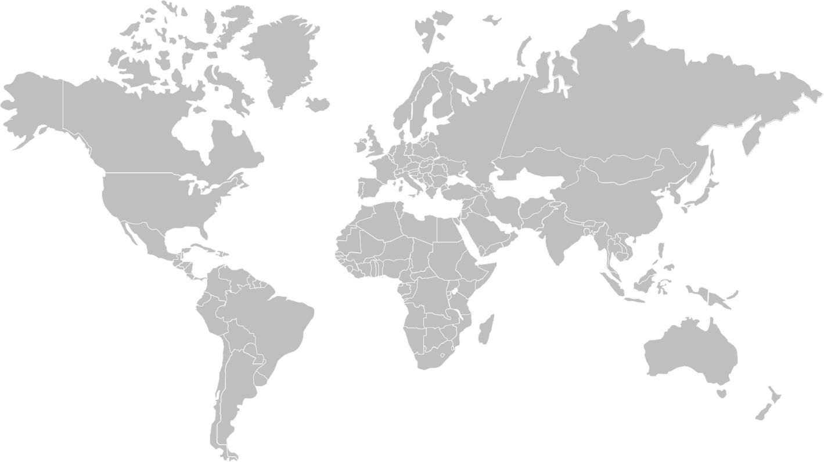

































Clients Reference

Slide 4
Evolution of Unified Business Operating System
From fragmented legacy to autonomous intelligence – Evolution from infrastructure → connectivity → intelligence → autonomy, and AVX is the execution layer for the next phase
Legacy ERP
Early ERP
Cloud Core
Mobile First
API Economy
Data Centric
AI Native
Hyper Auto
Predict Intel
Auto System
SAP/Oracle
On-Premise
Silos
Salesforce
Web 2.0
CRM Cloud
AWS/Azure
Mass Migrate
IaaS/Paas
Smartphone
Apps Era
Responsive
Microservices
REST/GraphQL
Integration
Analytics
ML Models
Real-Time
GenAI
LLMs
Copilots
Intelligent
Workflows
RPA+AI
Forecasting
Proactive
Anticipate
Self-Heal
Adaptive
Unified
2008
2013
2020
2030
2005
2010
2015
2025
2035
On-Premise
Cloud Era
Connected
Intelligent
Autonomous
Customer NPS
Customer NPS
-20%
+35%
Slower Delivery
Faster Delivery
Cost Reduction
Faster Execution
Productivity Gain
Data Accuracy
45%
76%
8X
99%
Open Savings
Streamlined Operations
Decision to Action
Accelerated Workflows
Per Knowledge Worker
AI-Augmented Teams
Real-Time Sync
Enterprise-Wide Consistency
Metrics based on observed enterprise transformations across telecom, utilities, and field-service environments

Slide 5





The Agentic Execution Plane for Enterprise
Three engines power a single, composable runtime — the agentic execution plane between AI and your enterprise
THE PROBLEM
THE SOLUTION
Enterprises Run on Broken Paradigms
Three Agentic Engines, One Composable Runtime
130+
40%
Apps per Company
Time Wasted
THE BRAIN
- Agentic BPMN
Siloed ITSM, PMO, FSM & EAM with zero cross-functional visibility
Poor physical-to-digital integration, broken workflows
Agents compose & govern workflows in real-time. Process logic adapts based on outcomes.
End-to-end orchestration as the authoritative execution layer
6–12 mo
Deploy Cycles
<10%
Automation
THE HANDS
- Agentic RPA
Slow & expensive customization
Limited real-time visibility for countermeasures
Agents execute across any system, APIs, UIs, databases, legacy with full auditability and error recovery.
MEASURABLE OUTCOMES
Non-intrusive automation for legacy & non-API systems
THE EYES
- Agentic BI
45%
Cost Reduction
99%
Data Accuracy
Agents observe outcomes, detect drift & self-optimize against KPIs, closing the loop automatically.
Unified, role-based analytics across orders, assets, workforce & incidents
76%
Faster Execution
<10d
Deploy Time
AirViewX | Execution That Can't Fail
The Agentic Framework with 35+ modules for Operations
Make strategic decisions that align with business objectives
Ensuring high-speed operations and zero errors
8X
Productivity

Slide 6














AirViewX Technology
BPMN - Process as the System of Execution
End-to-end, event-driven orchestration across CRM, catalog, fulfillment, field operations, and billing. BPMN acts as the authoritative execution layer, enforcing SLAs, dependencies, and cross-functional workflows—without hard-coded integrations.
Agentic Self Care
CRM
Customer Experience
Product & Services Catalog
RPA - Last-Mile & Legacy Automation
Non-intrusive automation for legacy, human-dependent, or non-API systems. RPA handles edge tasks and exception paths, while BPMN remains the source of truth—avoiding brittle, bot-centric architectures.
Workflow Automation
Order Capture to Fulfillment
BPMN
RPA
Resource Management
Asset Management
AI/ML - Agentic Intelligence Layer
AI/ML
BI/Analytics
Embedded AI agents for decisioning, prediction, and autonomous actions across operations. Powers self-care, intelligent routing, anomaly detection, root-cause analysis, and continuous process optimization—learning from every transaction.
Shift & Roster Management
IOT Tracking
Billing & payment Processing
Incident Management
Fieldforce Automation
BI/Analytics - Real-Time Operational Intelligence
Unified, role-based analytics across orders, assets, workforce, and incidents. Delivers real-time visibility, insight velocity, and outcome tracking, closing the loop from execution to optimization.

Slide 7
AirViewX Core
Three engines power a single, composable runtime — the agentic execution plane between AI and your enterprise
THE BRAIN
THE HANDS
THE EYES
Agentic BPMN
Agentic RPA
Agentic BI
Agents compose and govern workflows in real-time. Process logic adapts based on outcomes — not static flowcharts.
Agents execute across any system — APIs, UIs, databases, legacy — with full auditability and error recovery.
Agents observe outcomes, detect drift, and self-optimize against KPIs — closing the loop automatically.
End-to-end, event-driven orchestration across CRM, catalog, fulfillment, field ops, and billing. The authoritative execution layer.
Non-intrusive automation for legacy and non-API systems. RPA handles edge tasks while BPMN remains source of truth.
Unified, role-based analytics across orders, assets, workforce, and incidents. Real-time visibility to optimization.
35+ modules across Service Assurance · Customer & Commerce · Workforce & PMO · Network & Asset · Process & Data

Slide 8
The AirViewX Advantage
Where processes execute, agents decide, and intelligence compounds
Agents Compose Workflows
Governed Autonomy
Not humans designing static flowcharts. ZALA agents dynamically build and adapt process logic in real-time.
Policy guardrails, approval thresholds, full audit trails. Enterprise-grade trust baked into every agent decision.
Fewer integrations
Lower TCO
Faster rollout
Complex service mgmt
Enterprise reliability
Complete visibility
Self-Optimizing Operations
One Composable Runtime
Closed-loop BI that learns from every execution. Every cycle makes the next one smarter.
Single, low-code BOS natively spanning ITSM + BPM + FSM + EAM. Not 130+ SaaS tools stitched together.
Real-time sync
AI-powered insights
Continuous improvement
Microservices arch
Auto-scaling
AI-ready platform
Just as Kubernetes decoupled container orchestration from infrastructure, AirViewX decouples business execution from systems of record—a universal control plane where a field technician and an API endpoint are equivalent execution primitive
9

Slide 9
AirViewX Technology Stack
Experience
Web SPA / PWA · iOS & Android · Admin Portal · Self-Service Portal
Database
SQL Server · PostgreSQL · MySQL · Greenplum · ClickHouse · Multi-Tenant & Distributed
Mobile Stack
Flutter · Android (Native) · iOS (Native) · Progressive Web App (PWA)
Analytics
Real-Time Stream Analytics · Data Warehouse · Data Lake · KPI Data Marts
Frontend
Angular 17+ (TypeScript) · Bootstrap 5 · DevExtreme Controls · HTML5 / CSS3 · Javscript · JQuery
Reporting & BI
SSRS · Crystal Reports · Operational Dashboards · Executive Scorecards
Backend
C# .NET · ASP.NET Core · Node.js · MVC · Microservices · Event-Driven Architecture
Integration
REST APIs · GraphQL · Webhooks · API Gateway · ESB / Middleware · BSS Adapters
Connectivity
TCP/IP · WebSocket · WebRTC · MQTT · gRPC · SignalR
Security
OAuth 2.0 · OpenID Connect · SAML · LDAP · SSO · JWT · RBAC · MFA
Messaging
Apache Kafka · RabbitMQ · Pub-Sub · Stream Ingestion · Event-Driven Triggers
Infrastructure
On-Prem · Azure / AWS / GCP · Docker / Kubernetes · Cloudflare · CI/CD · Nginx · IIS
Data Services
Elasticsearch · GraphQL · Redis Cache · ETL / ELT Pipelines · Kafka Streams

Slide 10







AirViewX Detailed Functional Architecture
Unified Business Operating System (UBOS) — Complete Platform Capabilities
━ EXPERIENCE LAYER
Web Portal
Mobile App
Admin Console
Self-Service Portal
Field App
IoT Integrations
External Partners
━ CORE PLATFORM MODULES
CUSTOMER & SALES
OPERATIONS & PROJECTS
FIELD & ASSETS
SPATIAL & TOPOLOGY
MASTER DATA & DOCS
CRM
Project Mgmt
Field Force Automation
GIS
Entity Mgmt
Account Mgmt
Ticket Mgmt
Inventory Mgmt
Network Diagrams
Document Mgmt
Order Mgmt (CPQ)
Event Mgmt
IoT Tracking/Telemetry
Coverage Maps
Checklists
Products & Catalog
Diagnostics & Fault
Roster/Team Mgmt
Asset Locations
━ CONTROL PLANE / EXECUTION LAYER
Orchestration
SLA Engine
Unified Rules
AI Decisioning
Scheduling
Approvals
Queue Mgmt
Policy Engine
Notifications
━ AUTOMATION & INTELLIGENCE LAYER
BUSINESS PROCESS AUTOMATION
RPA & AUTOMATION
AI & ML INTEGRATION
BPMN Designer
Workflow Engine
RPA/BOT Orchestrations
Task Automation
Predictive Analytics
Smart Routing
Human in-loop Approval Flows
Event Listener &Triggers
Data Extraction
System Integration
AI Chatbot
Anomaly Detection
Rule Engine
Process Analytics & Audit Trails
Scheduled Jobs
Auto-Assignment
NLP Processing
Recommendation
━ ANALYTICS & DATA PIPELINE
DATA PIPELINE
ANALYTICS & BI
Event Streaming
ETL/ELT
CDC
Data Lake
Dashboards
KPI Monitoring
Custom Reports
Query Builder
Parsing Engine
Insights
━ INTEGRATION & SECURITY LAYER
API & Integration Services
Security & Compliance
API
Gateway
REST APIs
Webhooks
ESB/MQ
RBAC
Encryption
Audit Logs
SSO/LDAP
MuleSoft
Event Bus
MFA
Data Privacy
WAF
OAuth 2.0
GraphQL
gRPC
SOC 2
GDPR
ISO 27001
━ EXTERNAL SYSTEM INTEGRATIONS
+ more
Salesforce
Jira
Cerillion
SAP
Genesys
Twilio
ServiceNow
ArcGIS
Google Cloud
Azure
AWS
━ DATA & INFRASTRUCTURE LAYER
+ more
Redis
Elasticsearch
PostgreSQL
ClickHouse
S3/MinIO
KAFKA
Flow: Catalog → CPQ → Order Mgmt → BPMN → RPA → Provisioning
Confidential

Slide 11
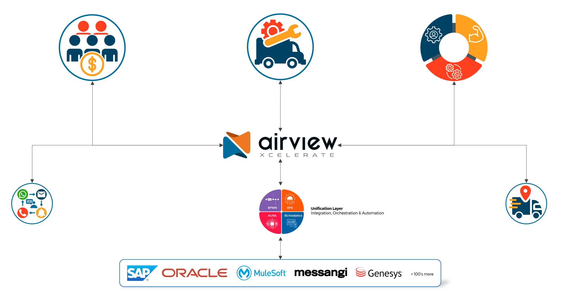












Beyond iPaaS, Low-Code, and Suites — A New Operating Layer
Zero touch automation / Cross Functional workflows /Physical to digital integration
Beachhead: High-Pain, High-ROI Verticals
Telecom & Managed Services
$15B
Market Size
Pain: Delayed activations, manual provisioning, gig truck rolls
Need: Zero-touch workflows, deployment automation, asset linage
Utilities/ Energy
$12B
Market Size
Pain: Legacy EAM + separate ITSM, compliance-heavy changes
Need: Unified change field maintenance, mobile safety checks
Construction/Facilities
$11B
Market Size
Pain: Disjointed work orders, inspections, vendor coordination
Need: Scheduling, site handovers, CAFM-style reporting
$47B+ (with 40% CAGR through 2030)
Public Sector
$9B
Automated
Pain: Fragmented systems, slow service delivery
Need: Integrated citizen services, compliance tracking
Telecom, utilities, Construction/Facilities, Public Sector estimated 40-45% of global demand.

Slide 12
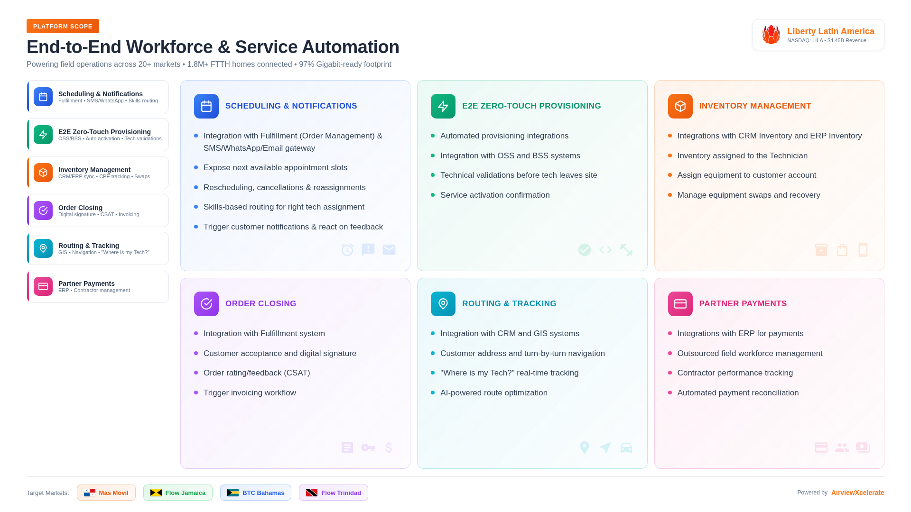
WFM Module Features Example

Slide 13
Roadmap
Progressive journey to full autonomy
2017 Q1
2018 Q1
2022 Q1
2023 Q1
2025 Q4
2026 Q3
2027 Q4
2028/2029 Q2
Conceptualized R&D
Deployed as SAAS
LLMS Integrated
Secured Pilot
Scaled to 3 Enterprise
Scale Product Features
5000 SME Customers
Conceptualized R&D
Architecture for Telecom, Utilities, Renewable Energy and Smart Cities
Service Delivery Projects as Internal Tool
With Telecom Giant
$3M ARR
Across Industries
~$2B+
Concept and R&D
Foundation Building
Current Stage
The Future Ahead
The Vision
Soft Launch
Orchestration Layer
Full Autonomy
Telecom, Utilities, Renewable energy and smart cities background
Gaps of the industry
UBOS vision
BPMN,RPA, AI/ML & BI core
Decision points & data flows
Launch pilot orchestrations across consulting enterprise as an internal and external tool
Deploy real-time data infrastructure
Build AI ready workflow execution plans
Build composable architecture
Deploy Agentic workflows
Human in loop controls
Deploy Industry-specific packs
Regulator Compliance
Advanced governance & security
End-to-end automation
Strategic human oversight only
Market leading differentiation
Data Infrastructure
AI Agent Capability
Industry Specialization
Full Autonomy
First Movers Capture 60% Market Share

Slide 14


1-973-462-8320
Get in Touch
info@airviewx.com
Confidential with Copyrights

